Slide 1
CS168: Discussion 1
Intro to the Internet I
Spring 2025

Slide 2
Agenda
Introductions
Logistics
Terms
Poking the Internet
Intro to Project Traceroute
Light discussion today

Slide 3
About Me
CS168 TA Picture Here (fun!)
I’m a X{th,nd,rd} year PhD student studying Networking and Systems with Scott Shenker and Sylvia Ratnasamy.
I’m from <origin>. I like <hobby1>, <hobby2>, and <hobby3>.
My office hours: Monday 10pm-11pm in Soda Hall 341B.
My email: gobears@berkeley.edu (Edstem is faster though)
Notes:
I suggest surveying the class - ask how many are EECS/CS majors, how many are something else. How many first, second, third, fourth years, or grad students. How many from California, how many from somewhere else. Also ask why they’re taking the class / what they want to learn. Great way to get to know them and break the ice.

Slide 4

About Me - Jaewon (He/Him)
I’m a senior studying EECS and ORMS. ⧹(⦁ᴗ⦁)⧸
I’m from South Bay. I like playing tennis, hiking, and urban exploration!
My office hours (Soda 411):
Mon: 1-2 PM
Wed: 11-1 PM
My email: jaewon.lee@berkeley.edu (please include “[CS 168]” in the subject; Edstem is faster though)
Notes:
I suggest surveying the class - ask how many are EECS/CS majors, how many are something else. How many first, second, third, fourth years, or grad students. How many from California, how many from somewhere else. Also ask why they’re taking the class / what they want to learn. Great way to get to know them and break the ice.

Slide 5

About Me - Ian (He/Him)
I’m a senior studying CS and DS.
I’m from the East Bay. I like playing basketball, tennis, and exploring new restaurants
My office hours (Soda 411):
Wed: 11-2 PM
My email: ihdong@berkeley.edu (please include “[CS 168]” in the subject; Edstem is faster though)
Notes:
I suggest surveying the class - ask how many are EECS/CS majors, how many are something else. How many first, second, third, fourth years, or grad students. How many from California, how many from somewhere else. Also ask why they’re taking the class / what they want to learn. Great way to get to know them and break the ice.

Slide 6

About Me - Hongbo (He/Him)
I’m a junior studying CS and Applied Math.
I’m from the South Bay. I like city-building games, urban hiking, and camping in Soda.
My office hours (Soda 411):
Tuesday: 12-3 PM
My email: hwei0@berkeley.edu (please include “[CS 168]” in the subject; Edstem is faster though)
Notes:
I suggest surveying the class - ask how many are EECS/CS majors, how many are something else. How many first, second, third, fourth years, or grad students. How many from California, how many from somewhere else. Also ask why they’re taking the class / what they want to learn. Great way to get to know them and break the ice.

Slide 7

About Me - Anita (She/Her)
I’m a senior studying CS.
I’m from the Bay. I like snowboarding, and learning cybersecurity.
My office hours (Soda 411):
Mon: 12-2 PM
Wed: 12-1 PM
My email: anitading556@berkeley.edu (please include “[CS 168]” in the subject; Edstem is faster though)

Slide 8
Logistics
Project 1A: Basic Traceroute
Deadline: Tuesday February 4
Project 1B: Traceroute Error Handling
Deadline: Friday February 14

Slide 9
Terms

Slide 10
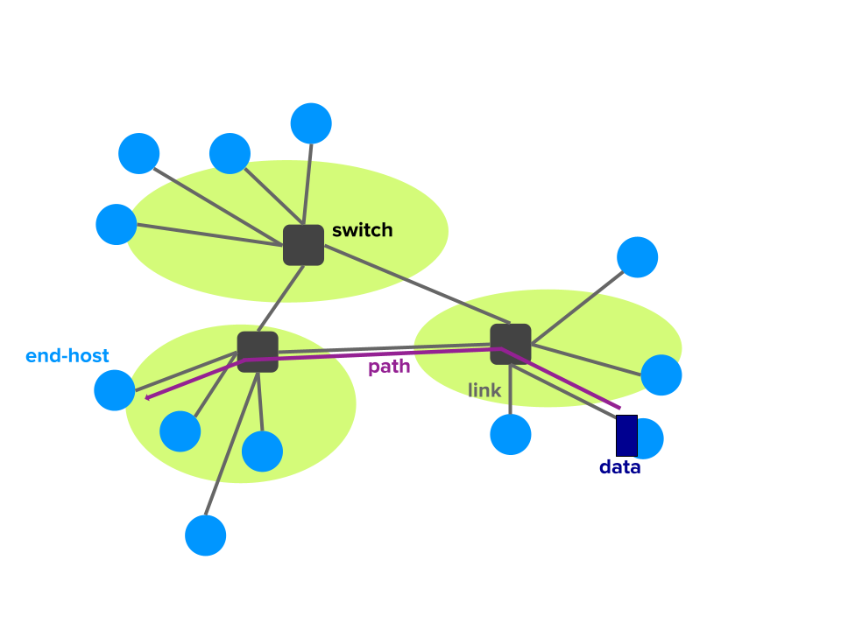
Terms
Routers/Switches: Devices that forward packets arriving on one link to another link. We make no distinction between routers/switches at this point
End-host: a device attached to the network that sends or receives packets.
Examples: mobile phone, laptop, security camera, smart fridge
Notes:
FEEL FREE TO CUSTOMIZE THESE TWO SLIDES IN YOUR OWN VERSION
Network
- Routers/Switches and links
Network Stack
- Networking SW on host. It replicates some routers/switch functionality then adds some additional network functionality before giving packet to application
Packets
- bags of bits. Consists of:
- Header w/meaningful info for network and network stack to make decisions
- Body containing a payload. Ex. A file, imagine, an application header, etc.
Routers/Switches
- devices that take a packet arriving on one of its incoming communication links and forwards said packet on one of its outgoing links. We make no distinction between routers/switches at this point because the difference is subtle
Application
- Most high level part of network connection, responsible for sending and receiving data as well as understanding the content of the data
Port:
- In routing context in the network, this refers to a physical port, which is responsible for providing a connection between routers/switches.
- In network stack and application context, this could be a logical port which is a means of which an application can connect to the network stack. (More on ports later in the semester)
Socket
- OS mechanism that connects processes to network stack via (logical) ports. More on this later..
Naming
- Network address: where host is located
- Network name: which host it is
- When you move a server to a new building, it’s name does not change but it’s address does
Internet Service Provider (ISP)
- Essentially an ISP is in itself a network of packet switches and communication links providing network access to end systems/links
Autonomous Systems (ASes)
- A group of routers that are under the same administrative control.
- Often routers in an ISP and the links that interconnect them constitute a single AS; however, some ISPs partition their network into multiple ASes
- Routers within the same AS will run the same routing algorithm and have information about each other
Routing table
- Table used by routers/switches to determine which outgoing link (port) to send a packet
Control plane
- mechanisms used to computer touting tables. i.e. concerned with determining/creating routing decisions
Data plane
- Using said tables to actually forward packets. i.e. concerned with the actual semantics/performance of forwarding packets
Circuit Switching
- method of data transfer in which an end system reserves BW along a path - sets up a circuit - for communication. No need for packets.
Packet Switching
- method of data transfer in which routers/switches service each packet they receive independently by inspecting its header

Slide 11
Terms
Packets: A Bags of bits with a
Header-- info for network and network stack to make decisions
Body-- contains a payload. Ex. A file, image, an application header
The network doesn’t really care about what’s in the payload.
“Go Bears”
Body
Header
Notes:
FEEL FREE TO CUSTOMIZE THESE TWO SLIDES IN YOUR OWN VERSION
Network
- Routers/Switches and links
Network Stack
- Networking SW on host. It replicates some routers/switch functionality then adds some additional network functionality before giving packet to application
Packets
- bags of bits. Consists of:
- Header w/meaningful info for network and network stack to make decisions
- Body containing a payload. Ex. A file, imagine, an application header, etc.
Routers/Switches
- devices that take a packet arriving on one of its incoming communication links and forwards said packet on one of its outgoing links. We make no distinction between routers/switches at this point because the difference is subtle
Application
- Most high level part of network connection, responsible for sending and receiving data as well as understanding the content of the data
Port:
- In routing context in the network, this refers to a physical port, which is responsible for providing a connection between routers/switches.
- In network stack and application context, this could be a logical port which is a means of which an application can connect to the network stack. (More on ports later in the semester)
Socket
- OS mechanism that connects processes to network stack via (logical) ports. More on this later..
Naming
- Network address: where host is located
- Network name: which host it is
- When you move a server to a new building, it’s name does not change but it’s address does
Internet Service Provider (ISP)
- Essentially an ISP is in itself a network of packet switches and communication links providing network access to end systems/links
Autonomous Systems (ASes)
- A group of routers that are under the same administrative control.
- Often routers in an ISP and the links that interconnect them constitute a single AS; however, some ISPs partition their network into multiple ASes
- Routers within the same AS will run the same routing algorithm and have information about each other
Routing table
- Table used by routers/switches to determine which outgoing link (port) to send a packet
Control plane
- mechanisms used to computer touting tables. i.e. concerned with determining/creating routing decisions
Data plane
- Using said tables to actually forward packets. i.e. concerned with the actual semantics/performance of forwarding packets
Circuit Switching
- method of data transfer in which an end system reserves BW along a path - sets up a circuit - for communication. No need for packets.
Packet Switching
- method of data transfer in which routers/switches service each packet they receive independently by inspecting its header

Slide 12
Terms
Naming:
Network name: which host it is
Network address: where host is located
When you move a server to a new building, its name does not change but its address does
Name: mywebsite.com
Addr: 142.250.72.206
Name: mywebsite.com
Addr: 208.117.236.69
Notes:
FEEL FREE TO CUSTOMIZE THESE TWO SLIDES IN YOUR OWN VERSION
Network
- Routers/Switches and links
Network Stack
- Networking SW on host. It replicates some routers/switch functionality then adds some additional network functionality before giving packet to application
Packets
- bags of bits. Consists of:
- Header w/meaningful info for network and network stack to make decisions
- Body containing a payload. Ex. A file, imagine, an application header, etc.
Routers/Switches
- devices that take a packet arriving on one of its incoming communication links and forwards said packet on one of its outgoing links. We make no distinction between routers/switches at this point because the difference is subtle
Application
- Most high level part of network connection, responsible for sending and receiving data as well as understanding the content of the data
Port:
- In routing context in the network, this refers to a physical port, which is responsible for providing a connection between routers/switches.
- In network stack and application context, this could be a logical port which is a means of which an application can connect to the network stack. (More on ports later in the semester)
Socket
- OS mechanism that connects processes to network stack via (logical) ports. More on this later..
Naming
- Network address: where host is located
- Network name: which host it is
- When you move a server to a new building, it’s name does not change but it’s address does
Internet Service Provider (ISP)
- Essentially an ISP is in itself a network of packet switches and communication links providing network access to end systems/links
Autonomous Systems (ASes)
- A group of routers that are under the same administrative control.
- Often routers in an ISP and the links that interconnect them constitute a single AS; however, some ISPs partition their network into multiple ASes
- Routers within the same AS will run the same routing algorithm and have information about each other
Routing table
- Table used by routers/switches to determine which outgoing link (port) to send a packet
Control plane
- mechanisms used to computer touting tables. i.e. concerned with determining/creating routing decisions
Data plane
- Using said tables to actually forward packets. i.e. concerned with the actual semantics/performance of forwarding packets
Circuit Switching
- method of data transfer in which an end system reserves BW along a path - sets up a circuit - for communication. No need for packets.
Packet Switching
- method of data transfer in which routers/switches service each packet they receive independently by inspecting its header

Slide 13
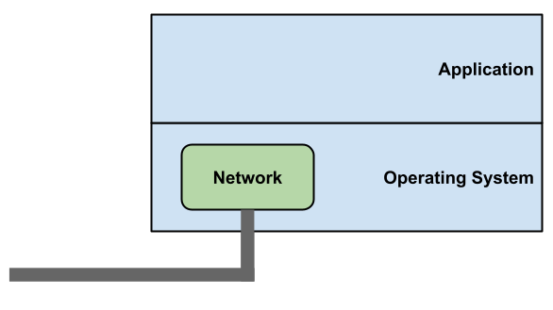
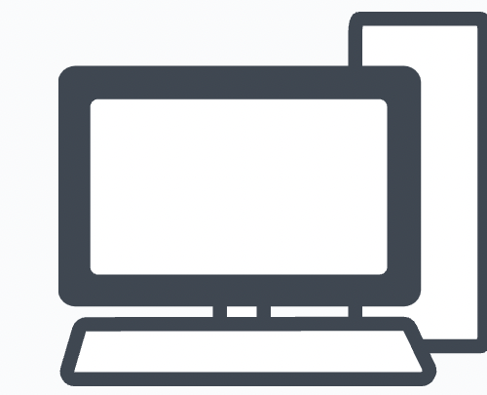

Terms
Network “Stack”: Networking Software on host.
Replicates some router/switch functionality and adds some additional functionality before passing the body of packets to the application
Notes:
FEEL FREE TO CUSTOMIZE THESE TWO SLIDES IN YOUR OWN VERSION
Network
- Routers/Switches and links
Network Stack
- Networking SW on host. It replicates some routers/switch functionality then adds some additional network functionality before giving packet to application
Packets
- bags of bits. Consists of:
- Header w/meaningful info for network and network stack to make decisions
- Body containing a payload. Ex. A file, imagine, an application header, etc.
Routers/Switches
- devices that take a packet arriving on one of its incoming communication links and forwards said packet on one of its outgoing links. We make no distinction between routers/switches at this point because the difference is subtle
Application
- Most high level part of network connection, responsible for sending and receiving data as well as understanding the content of the data
Port:
- In routing context in the network, this refers to a physical port, which is responsible for providing a connection between routers/switches.
- In network stack and application context, this could be a logical port which is a means of which an application can connect to the network stack. (More on ports later in the semester)
Socket
- OS mechanism that connects processes to network stack via (logical) ports. More on this later..
Naming
- Network address: where host is located
- Network name: which host it is
- When you move a server to a new building, it’s name does not change but it’s address does
Internet Service Provider (ISP)
- Essentially an ISP is in itself a network of packet switches and communication links providing network access to end systems/links
Autonomous Systems (ASes)
- A group of routers that are under the same administrative control.
- Often routers in an ISP and the links that interconnect them constitute a single AS; however, some ISPs partition their network into multiple ASes
- Routers within the same AS will run the same routing algorithm and have information about each other
Routing table
- Table used by routers/switches to determine which outgoing link (port) to send a packet
Control plane
- mechanisms used to computer touting tables. i.e. concerned with determining/creating routing decisions
Data plane
- Using said tables to actually forward packets. i.e. concerned with the actual semantics/performance of forwarding packets
Circuit Switching
- method of data transfer in which an end system reserves BW along a path - sets up a circuit - for communication. No need for packets.
Packet Switching
- method of data transfer in which routers/switches service each packet they receive independently by inspecting its header

Slide 14

Terms (cont’d)
ISP (Internet Service Provider): A network of packet switches and links that provide network access (i.e. Comcast, ATT, Sonic)
ASes (Autonomous Systems): Groups of routers under the same control
Usually each ISP has one AS, but may have multiple ASes
Routers within the same AS will have information about each other
Notes:
Network
- Routers/Switches and links
Network Stack
- Networking SW on host. It replicates some routers/switch functionality then adds some additional network functionality before giving packet to application
Packets
- bags of bits. Consists of:
- Header w/meaningful info for network and network stack to make decisions
- Body containing a payload. Ex. A file, imagine, an application header, etc.
Routers/Switches
- devices that take a packet arriving on one of its incoming communication links and forwards said packet on one of its outgoing links. We make no distinction between routers/switches at this point because the difference is subtle
Application
- Most high level part of network connection, responsible for sending and receiving data as well as understanding the content of the data
Port:
- In routing context in the network, this refers to a physical port, which is responsible for providing a connection between routers/switches.
- In network stack and application context, this could be a logical port which is a means of which an application can connect to the network stack. (More on ports later in the semester)
Socket
- OS mechanism that connects processes to network stack via (logical) ports. More on this later..
Naming
- Network address: where host is located
- Network name: which host it is
- When you move a server to a new building, it’s name does not change but it’s address does
Internet Service Provider (ISP)
- Essentially an ISP is in itself a network of packet switches and communication links providing network access to end systems/links
Autonomous Systems (ASes)
- A group of routers that are under the same administrative control.
- Often routers in an ISP and the links that interconnect them constitute a single AS; however, some ISPs partition their network into multiple ASes
- Routers within the same AS will run the same routing algorithm and have information about each other
Routing table
- Table used by routers/switches to determine which outgoing link (port) to send a packet
Control plane
- mechanisms used to computer touting tables. i.e. concerned with determining/creating routing decisions
Data plane
- Using said tables to actually forward packets. i.e. concerned with the actual semantics/performance of forwarding packets
Circuit Switching
- method of data transfer in which an end system reserves BW along a path - sets up a circuit - for communication. No need for packets.
Packet Switching
- method of data transfer in which routers/switches service each packet they receive independently by inspecting its header

Slide 15
Poking the Internet

Slide 16
Ping, Traceroute, Dig
Internet is large and complex. Network engineers and researchers have built some handy tools to get some insight into what is going on inside and across the internet.
We’re going to play around with them a little bit
Think of this as a “tinker discussion” - you aren’t expected to know any of these concepts yet. We’ll learn about them throughout the semester.

Slide 17
Ping, Traceroute, Dig
Simple utility that lets you “poke” a website and see if it moves (spoiler: most do!)
You say hi and see if the server says hi back
This by itself is not super interesting
Ping also tells you how long the reply took to come back
This is more interesting!
Let’s try out a few websites.
Notes:
Instructions on Next slide!
Command: ping <website>
If you add “-4” in windows, it will force IPv4
Websites: Berkeley (berkeley.edu), Google, Github, Microsoft (no response), zu.ac.tz (Zanzibar University Login), allspice.lcs.mit.edu, www.vutbr.cz (Brno University, Czech Republic)
Ping google.co.uk at the end
It should take about the same time to ping google.co.uk as google.com => google is smart enough to configure their DNS entries to allow anycast to work well across TLDs

Slide 18
Ping, Traceroute, Dig
Predictions?
berkeley.edu
google.com
ford.com (Ford, a car company headquartered in Michigan)
csail.mit.edu (MIT’s CS department)
lmu.de (University of Munich)
unam.edu.na (University of Namibia)
Notes:
Try these one by one. Have students guess before you run ping. Project your screen as your run ping in terminal.

Slide 19
Ping: A prediction
We’ve pinged a couple websites and seen pretty significant differences in latency.
Latency is the time between when a request is sent and when the response is heard.
What about differences in latency for the same website, but in different regions?
We’ve pinged google.com and seen its latency.
How many times longer will it take for a ping to google.co.uk to come back?
Notes:
Ping google.co.uk
It should take about the same time to ping google.co.uk as google.com => google is smart enough to configure their DNS entries to allow anycast to work well across TLDs

Slide 20
Ping, Traceroute, Dig
ping berkeley.edu -c 3
PING berkeley.edu (141.193.213.21): 56 data bytes
64 bytes from 141.193.213.21: icmp_seq=0 ttl=50 time=14.142 ms
64 bytes from 141.193.213.21: icmp_seq=1 ttl=50 time=20.024 ms
64 bytes from 141.193.213.21: icmp_seq=2 ttl=50 time=17.540 ms
--- berkeley.edu ping statistics ---
3 packets transmitted, 3 packets received, 0.0% packet loss
round-trip min/avg/max/stddev = 14.142/17.235/20.024/2.411 ms
ping csail.mit.edu -c 3
PING csail.mit.edu (128.52.132.19): 56 data bytes
64 bytes from 128.52.132.19: icmp_seq=0 ttl=32 time=108.253 ms
64 bytes from 128.52.132.19: icmp_seq=1 ttl=32 time=109.574 ms
64 bytes from 128.52.132.19: icmp_seq=2 ttl=32 time=98.613 ms
--- csail.mit.edu ping statistics ---
3 packets transmitted, 3 packets received, 0.0% packet loss
round-trip min/avg/max/stddev = 98.613/105.480/109.574/4.886 ms
Notes:
Try these one by one. Have students guess before you run ping. Project your screen as your run ping in terminal.

Slide 21
Ping, Traceroute, Dig
Tool to trace the route that packets take from your computer to the destination.
Specifically lets you see the routers/switches that are forwarding your packets.
1
2
Notes:
“How?” section moved to bonus slides, can discuss at end of section if students are curious.
Command(linux, macOS): traceroute <website>
Command(Windows) tracert <website>
NOTE: CENIC = Corporation for Education Network Initiatives in California (Powerful networks for CA Univerisites)

Slide 22
Ping, Traceroute, Dig
Traceroute gives you the path of routers and switches your packets take.
How?
Takes advantage of something called a TTL in the packet IP header.
TTL denotes how many times a packet should be forwarded before it is discarded.
Why does this exist?
To stop the internet from collapsing! (We’ll cover this when we get to routing)
Sets the TTL to 1, 2, 3, etc
When packets are dropped because of TTL expiring, most routers send back a message telling us.
Use the source of this notification to identify the routers along the packet’s path.

Slide 23
Ping, Traceroute, Dig
Demo, pick your favorite(s):
berkeley.edu
google.com
csail.mit.edu (MIT’s CS department)
ford.com (Ford, a car company headquartered in Michigan)
lmu.de (University of Munich)
unam.edu.na (University of Namibia)
Now let’s visualize it online at geotraceroute.com
Notes:
“How?” section moved to bonus slides, can discuss at end of section if students are curious.
Command(linux, macOS): traceroute <website>
Command(Windows) tracert <website>
NOTE: CENIC = Corporation for Education Network Initiatives in California (Powerful networks for CA Univerisites)

Slide 24
traceroute berkeley.edu
traceroute: Warning: berkeley.edu has multiple addresses; using 141.193.213.20
traceroute to berkeley.edu (141.193.213.20), 64 hops max, 40 byte packets
1 sut-mdc-sr9--ae0-558.net.berkeley.edu (10.40.232.2) 6.154 ms 10.428 ms 7.135 ms
2 sut-mdc-cr1--xe-2-1-13.net.berkeley.edu (128.32.255.96) 16.284 ms 19.354 ms 7.312 ms
3 reccev-cev-cr2--et-0-2-8.net.berkeley.edu (128.32.255.177) 5.652 ms
sut-mdc-cr2--et-0-2-8.net.berkeley.edu (128.32.255.41) 10.454 ms *
4 * * *
5 * sut-mdc-fw9--xe-0-0-1-3.net.berkeley.edu (128.32.255.143) 6.366 ms 5.512 ms
6 reccev-cev-sr1--xe-0-1-1-0-2.net.berkeley.edu (128.32.255.140) 5.309 ms 4.949 ms 5.388 ms
7 reccev-cev-sr1--lt-0-1-0-0.net.berkeley.edu (128.32.255.166) 4.160 ms 5.037 ms 4.338 ms
8 reccev-cev-cr2--et-0-0-0-3.net.berkeley.edu (128.32.255.74) 5.742 ms 9.072 ms 7.551 ms
9 sut-mdc-cr1--et-0-1-0.net.berkeley.edu (128.32.255.40) 7.412 ms
sut-mdc-cr1--et-0-1-5.net.berkeley.edu (128.32.255.176) 5.063 ms
reccev-cev-cr1--et-0-1-0.net.berkeley.edu (128.32.255.174) 6.135 ms
10 reccev-cev-br1--et-1-1-1.net.berkeley.edu (128.32.0.38) 4.994 ms 5.771 ms
reccev-cev-br1--et-1-1-0.net.berkeley.edu (128.32.0.36) 5.349 ms
11 emvl1-agg-01--ucb--100g.cenic.net (137.164.3.26) 9.055 ms 5.400 ms 5.872 ms
12 svl-agg10--emvl1-agg-01--400g--01.cenic.net (137.164.11.94) 9.312 ms 9.272 ms 8.780 ms
13 198.32.251.193 (198.32.251.193) 18.352 ms * 33.886 ms
14 172.68.188.80 (172.68.188.80) 10.743 ms
172.68.188.94 (172.68.188.94) 10.407 ms
172.68.188.80 (172.68.188.80) 26.217 ms
15 141.193.213.20 (141.193.213.20) 8.597 ms 9.852 ms 8.677 ms
Notes:
Try these one by one. Have students guess before you run ping. Project your screen as your run ping in terminal.

Slide 25
Traceroute: Notice anything?
Traceroute gives us a lot more interesting feedback than ping.
Latency to every step along the way.
Can see a breakdown of latencies!
Router names.
Often have locations in them (i.e. city name)
Can roughly trace packet path on a map!
Weird stars
Some routers just don’t respond ⁻\_(ツ)_/⁻
Notes:
Stars may also mean that it timed out

Slide 26
Ping, Traceroute, Dig
When humans want to go to a website, we think in terms of names
i.e. google.com
The internet does not think this way, it thinks in terms of addresses
i.e. “1.2.3.4”
It’s like the postal service
You wouldn’t just write “To: Alice” on a letter
You would look up Alice’s address in some directory
Then mail the letter to her address
Dig lets you lookup the address of a website by its name
Command line interface to the Domain Name Service (DNS)
Notes:
Make sure to try with the +trace option.
-Explanation in Old slides at the bottom
Websites: berkeley.edu
google.com
csail.mit.edu (MIT’s CS department)
ford.com (Ford, a car company headquartered in Michigan)
rural.pa.gov (Rural Pennsylvania)
unam.edu.na (University of Namibia)

Slide 27
Dig: A breakdown
When using the +trace option, there was a lot more information
We could see the steps that were taken when resolving the names
First, the ‘root’ servers were queried
Then, the TLD (top level domain) server was queried
After that, successive servers were asked until the IP was found
More on how this works when we discuss DNS

Slide 28
Ping, Traceroute, Dig
Demo
berkeley.edu
google.com
csail.mit.edu (MIT’s CS department)
ford.com (Ford, a car company headquartered in Michigan)
lmu.de (University of Munich)
unam.edu.na (University of Namibia)
(optionally see approximate physical location at https://www.iplocation.net/)
Notes:
Make sure to try with the +trace option.
-Explanation in Old slides at the bottom
Websites: berkeley.edu
google.com
csail.mit.edu (MIT’s CS department)
ford.com (Ford, a car company headquartered in Michigan)
rural.pa.gov (Rural Pennsylvania)
unam.edu.na (University of Namibia)

Slide 29
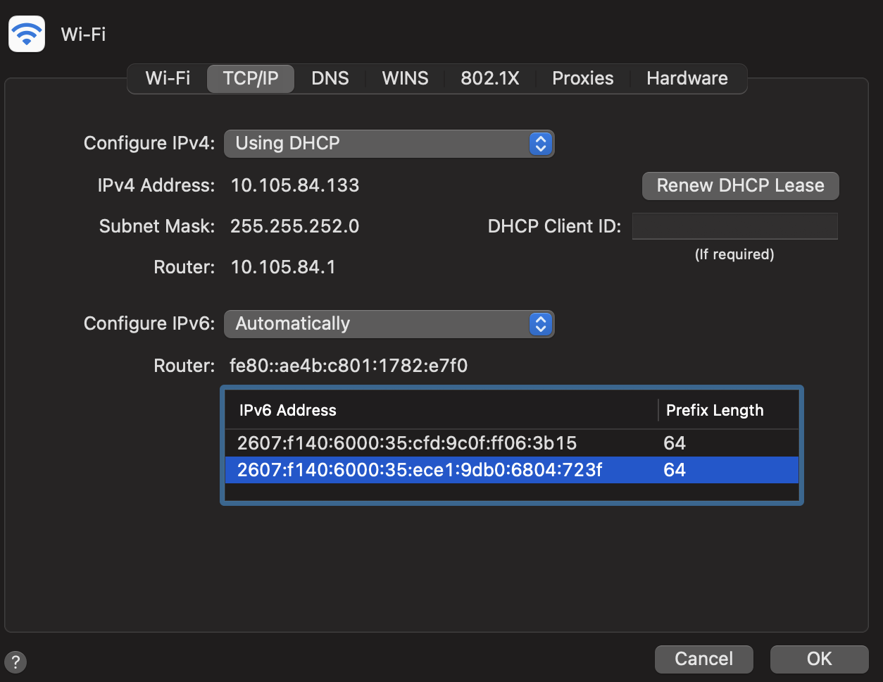
Bonus: What’s your IP Address?
On a Mac, go to System Preferences -> Network -> Advanced -> TCP/IP:

Slide 30

Questions?
Feedback Form: https://tinyurl.com/cs168-sp25-dis

